Slide 1
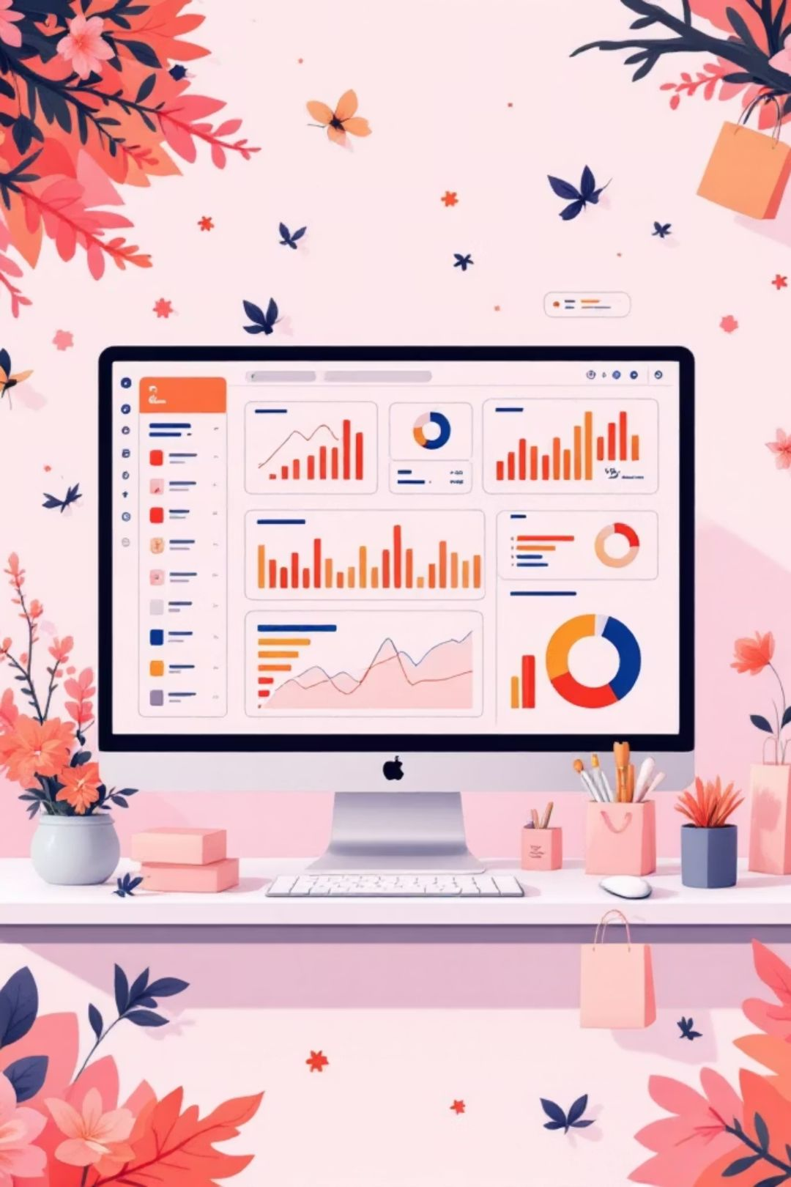
Customer Shopping Behavior Analysis
Uncovering insights from 3,900 purchases to guide strategic business decisions

Slide 2
Dataset Overview
3,900
18
37
Transactions
Features
Missing Values
Purchase records analyzed
Data points per transaction
Review ratings imputed
Key Features
Python Processing
Customer demographics
Purchase details
Shopping behavior
Data cleaning
Feature engineering
Database integration

Slide 3
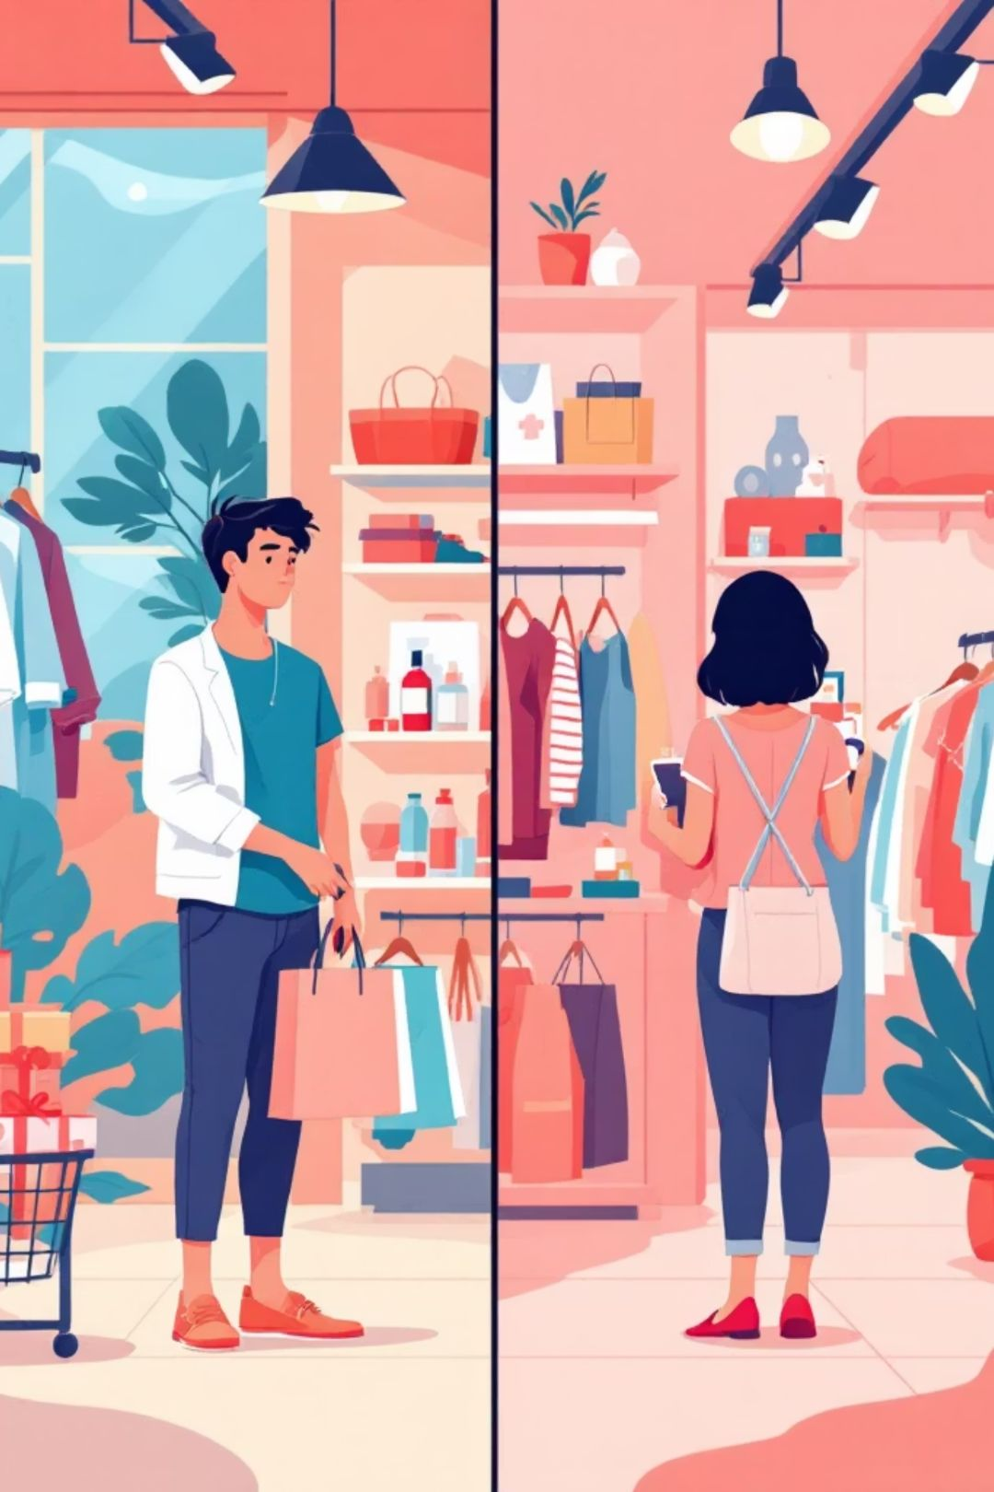
Revenue by Gender
Male Customers
$157,890 total revenue
Higher spending segment
Female Customers
$75,191 total revenue
Significant opportunity

Slide 4

Product Performance
Top-Rated Products
Discount-Heavy Products
Gloves (3.86 avg)
Sandals (3.84 avg)
Boots (3.82 avg)
Hat (3.80 avg)
Skirt (3.78 avg)
Hat (50% discounted)
Sneakers (49.66%)
Coat (49.07%)
Sweater (48.17%)
Pants (47.37%)

Slide 5

Shipping & Subscriptions
Shipping Preference
Standard: $58.46 avg
Express: $60.48 avg
Minimal difference
Subscription Impact
Subscribers: $59.49 avg
Non-subscribers: $59.87 avg
Similar spending patterns

Slide 6



Customer Segmentation
79%
18%
2%
Loyal Customers
Returning
New
3,116 repeat buyers
701 customers
83 customers

Slide 7
Revenue by Age Group
24%
23%
Young Adult
Middle-aged
$62,143 revenue
$59,197 revenue
22%
22%
Adult
Senior
$55,978 revenue
$55,763 revenue
Young adults drive highest revenue

Slide 8

Top Products by Category
Accessories
Clothing
Jewelry: 171 orders
Blouse: 171 orders
Sunglasses: 161 orders
Pants: 171 orders
Belt: 161 orders
Shirt: 169 orders
Footwear
Outerwear
Sandals: 160 orders
Jacket: 163 orders
Shoes: 150 orders
Coat: 161 orders
Sneakers: 145 orders

Slide 9

Key Insights
High-Spending Discount Users
Repeat Buyers Subscribe
839 customers used discounts while spending above average
958 repeat buyers vs. 2,518 non-repeaters
Discount Strategy
Balance sales boosts with margin control

Slide 10
Strategic Recommendations
01
02
03
Boost Subscriptions
Customer Loyalty Programs
Review Discount Policy
Promote exclusive benefits for subscribers
Reward repeat buyers to move into "Loyal" segment
Balance sales boosts with margin control
04
05
Product Positioning
Targeted Marketing
Highlight top-rated and best-selling products in campaigns
Focus on high-revenue age groups and express-shipping users

